Slide 1
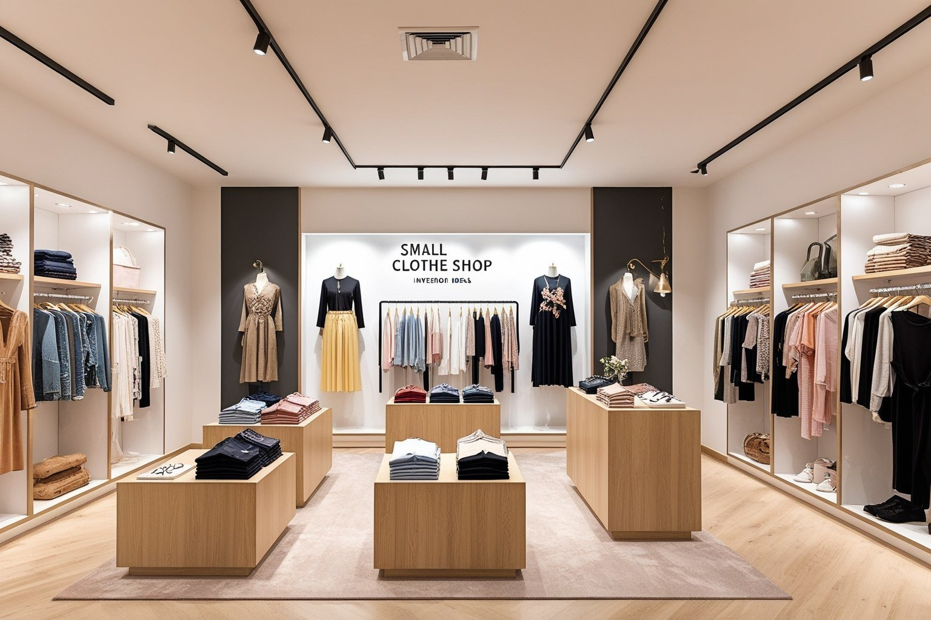


2026
CloThinks
AI-Driven Inventory Intelligence for SME Fashion Retailers
UMHackathon 2026
umhackathon@um.edu.my

Slide 2

01
Introduction
02
Background & Objective
Problem statement and proposed solution
Our story and business impact
Table of Content
03
Product Purpose
04
System Functionalities
Main goal and target users
Key features and capabilities
Discover how CloThinks transforms fashion retail through AI-powered intelligence
05
User Stories
06
Features & Benefits
Real-world use cases
What we deliver

Slide 3




Problem Statement
Fashion SMEs lose profit due to poor inventory decisions
Heavy reliance on intuition and fragmented data leads to overstocking, deadstock, and missed sales opportunities.
Lack of analytical tools
Current systems do not provide actionable insights
Target Domain
Introduction
AI-driven Inventory Intelligence for SME Fashion Retailers
Proposed Solution
Transforming Fashion Retail Intelligence
Real-time Tracking
AI Fashion Stylist
Demand Prediction
Detecting slow-moving items

Slide 4
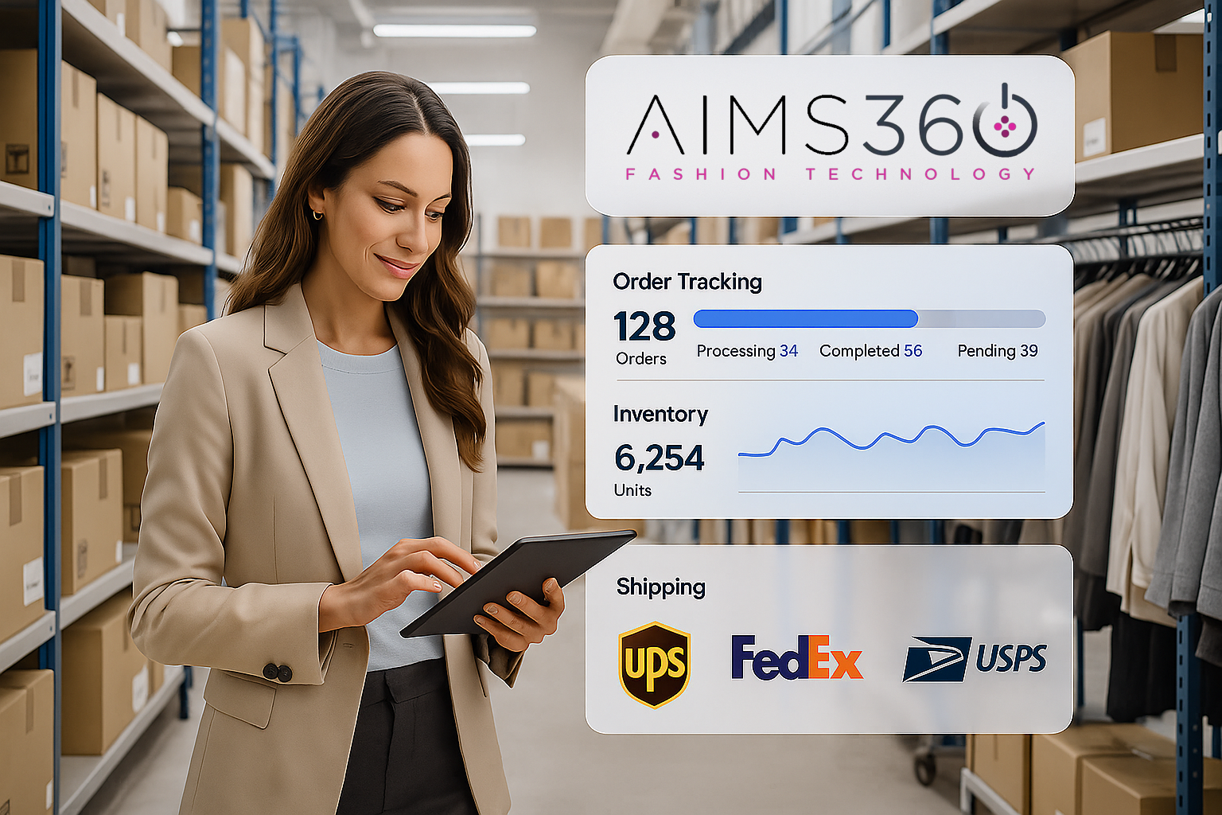



OUR STORY
From Intuition to Intelligence
The Challenge
Store owners rely on gut feelings rather than data. Fragmented information across notebooks and spreadsheets
Why It Matters
Reduce capital trapped in deadstock. Minimise textile waste. Compete with large corporations
Strategic Impact
AI-driven real-time insights. Faster & clearer decision-making. Sustainable fashion ecosystem.
Transform Operations
From manual tracking to intelligent insights

Slide 5










Main Goal
Turn Deadstock Into Revenue
Eliminate financial waste from unsold stock while increasing sales through intelligent size and style-based customer matching from existing inventory to create attractive bundles
Intended Users
Your AI-Powered Inventory & Styling Partner
SME Fashion Retailers
Store/Inventory Managers
Production Staff
Online Customers
Small Online Sellers
Fabric Wholesalers
Eliminate Waste • Increase Sales

Slide 6
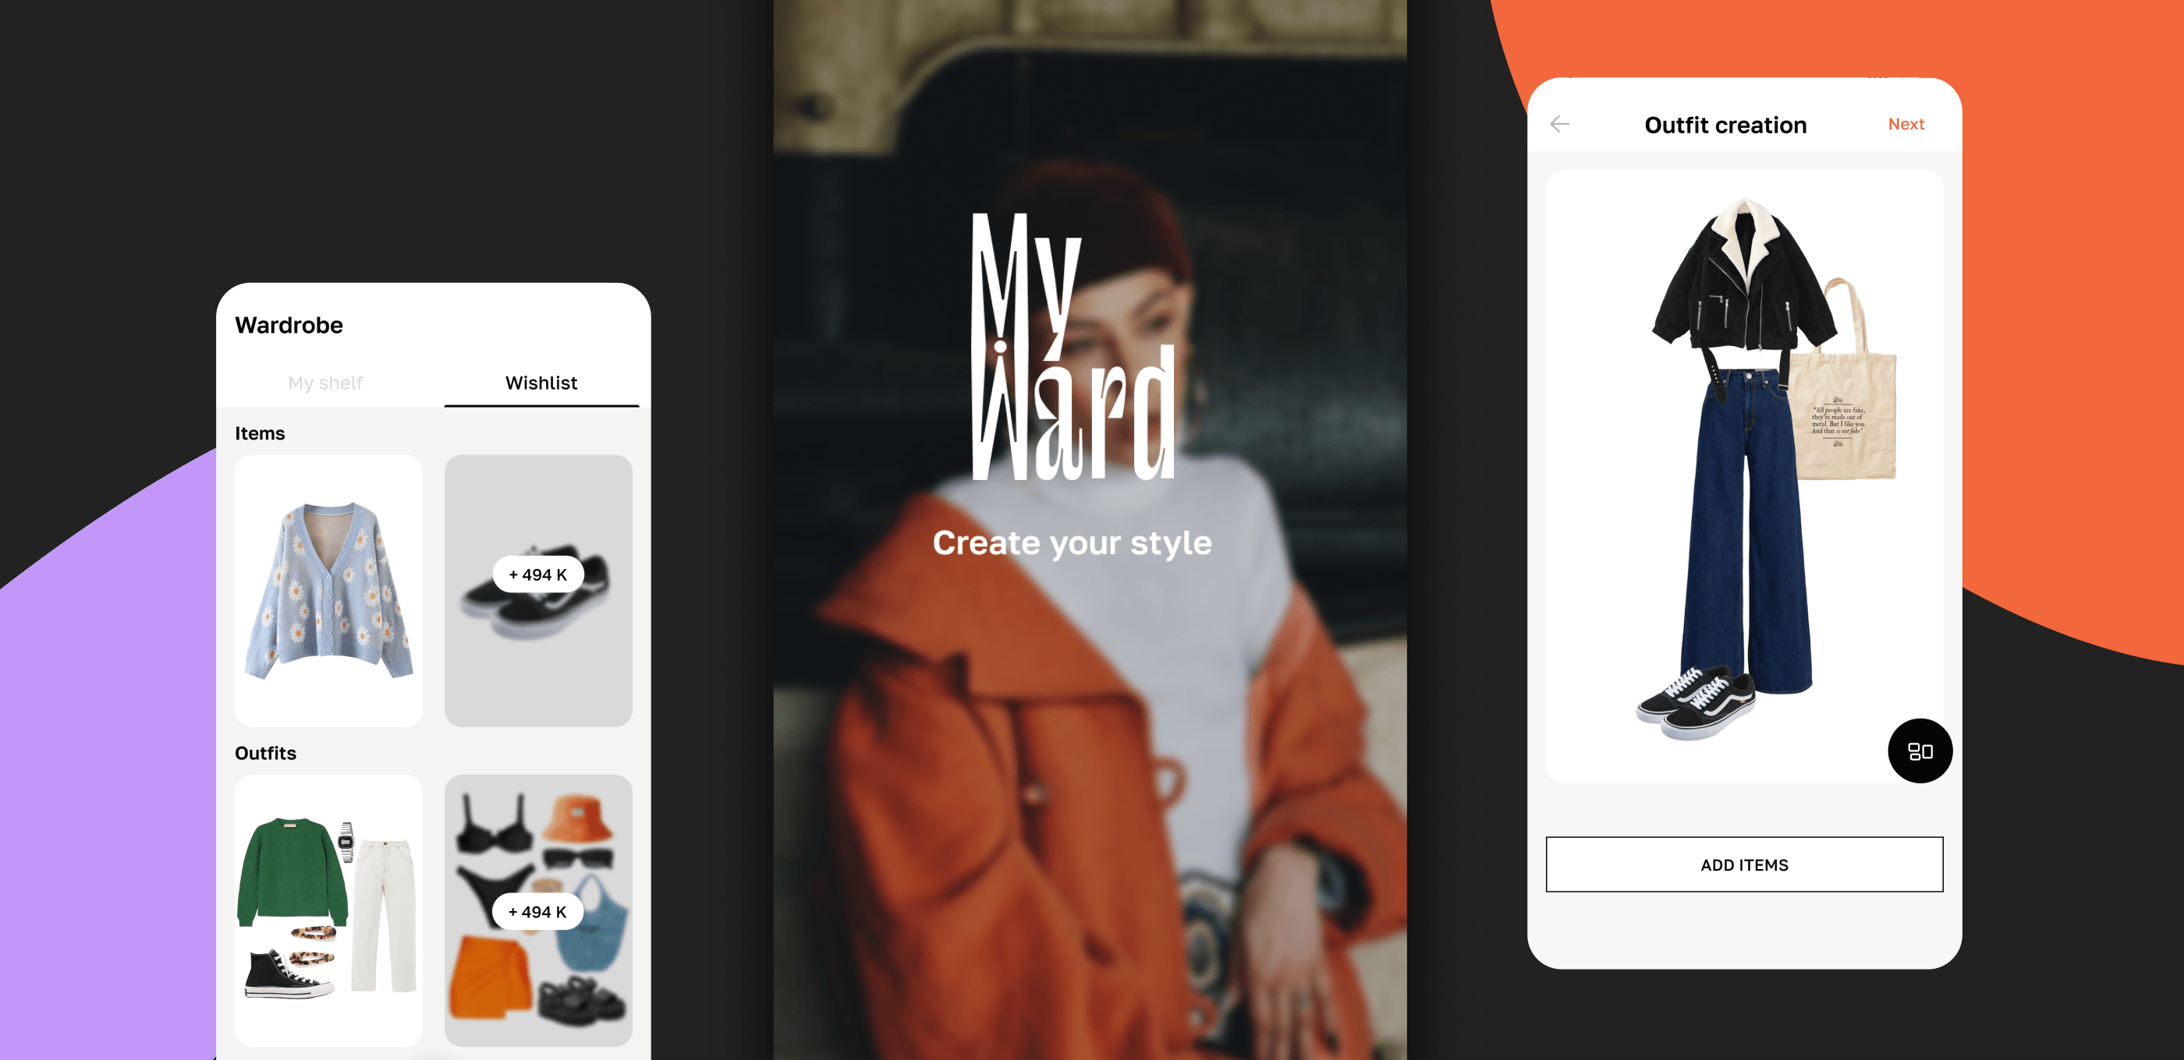




System Functionalities
Powerful Features for Fashion Retail
Smart Inventory Intelligence
Conversational Interface
• Real-time stock tracking
• Natural English prompts
• Sales pattern analysis
• Easy interaction
• Overstock identification
• Intuitive design
AI Outfit Matching
Demand Prediction
• Outfit combinations/ bundles
• Forecast trends
• From existing inventory
• Restocking suggestions
• Convert unsold items
• Bundling strategies
AI-Powered Styling Interface

Slide 7












How It Works
Just a simple prompt turns into smart decisions
01
02
03
Real-Time Tracking
AI Outfit Generation
Strategic Sales Recommendations
Monitor stock levels instantly
Match unsold with trending items
Predict demand trends
Analyze sales patterns
Create sellable bundles
Optimize restocking decisions
Identify slow-moving items
Turn deadstock into profit
Reduce waste significantly
Proactive management
Increase customer appeal
Maximize revenue growth

Slide 8
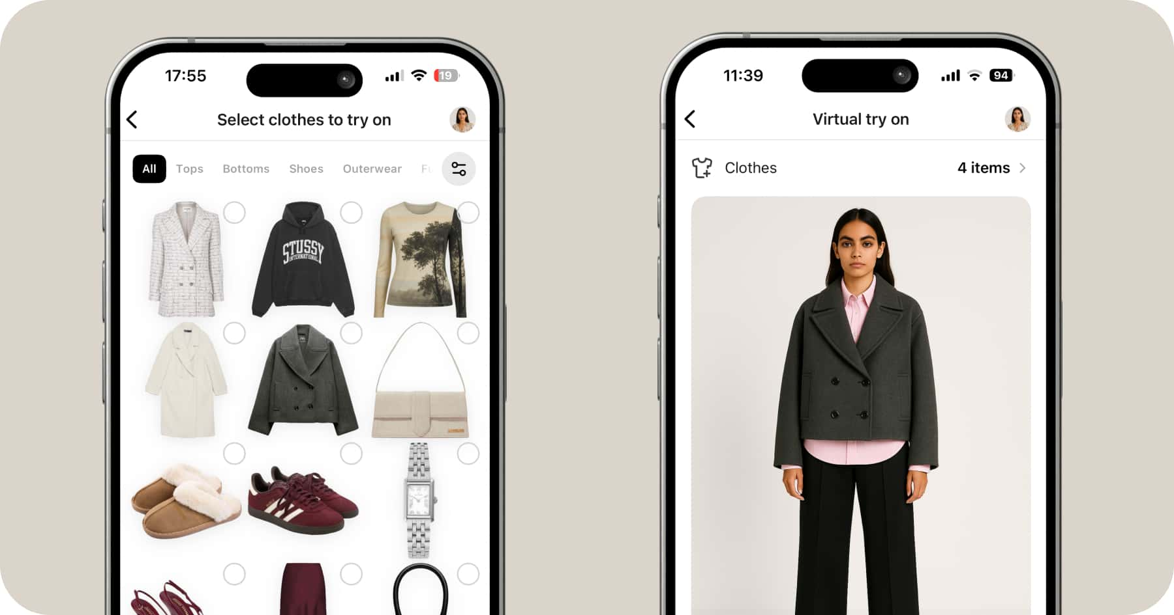

User Stories
Real-World Applications
Fashion Retailer
I want to identify slow-moving stock and receive AI-suggested pairing combinations with trending items, so I can predict demand and restock strategically.
Fashion Shopper
I want personalized outfit recommendations based on local trends and my style preferences, so I can make confident purchasing decisions.
AI-Powered Virtual Try-On

Slide 9







Features & Benefits
What We Deliver
AI-powered inventory analytics dashboard
All-in-one system (inventory, styling, AI support
Outfit recommendation engine from stock
Demand prediction and stock alerts
Customer personalized style matching
Conversational natural language interface
Key Benefits
✓
Reduce waste and deadstock
Increase sales with smart matching
✓
✓
Optimize inventory in real-time
Improve customer satisfaction
✓

Slide 10




Thank You
Transforming Fashion Retail with AI Intelligence
CloThinks
Empowering SME Fashion Retailers
Smart Inventory
AI Styling
Data-Driven Decisions

